Slide 1
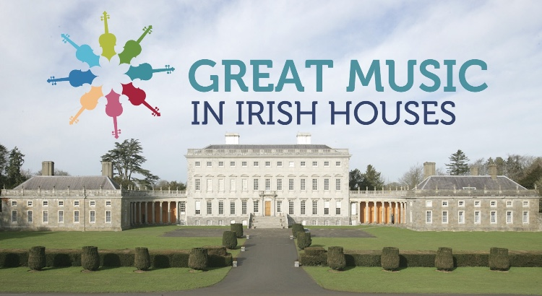
Great Music in Irish Houses Festival - Connecting with the Digital Public

Slide 2
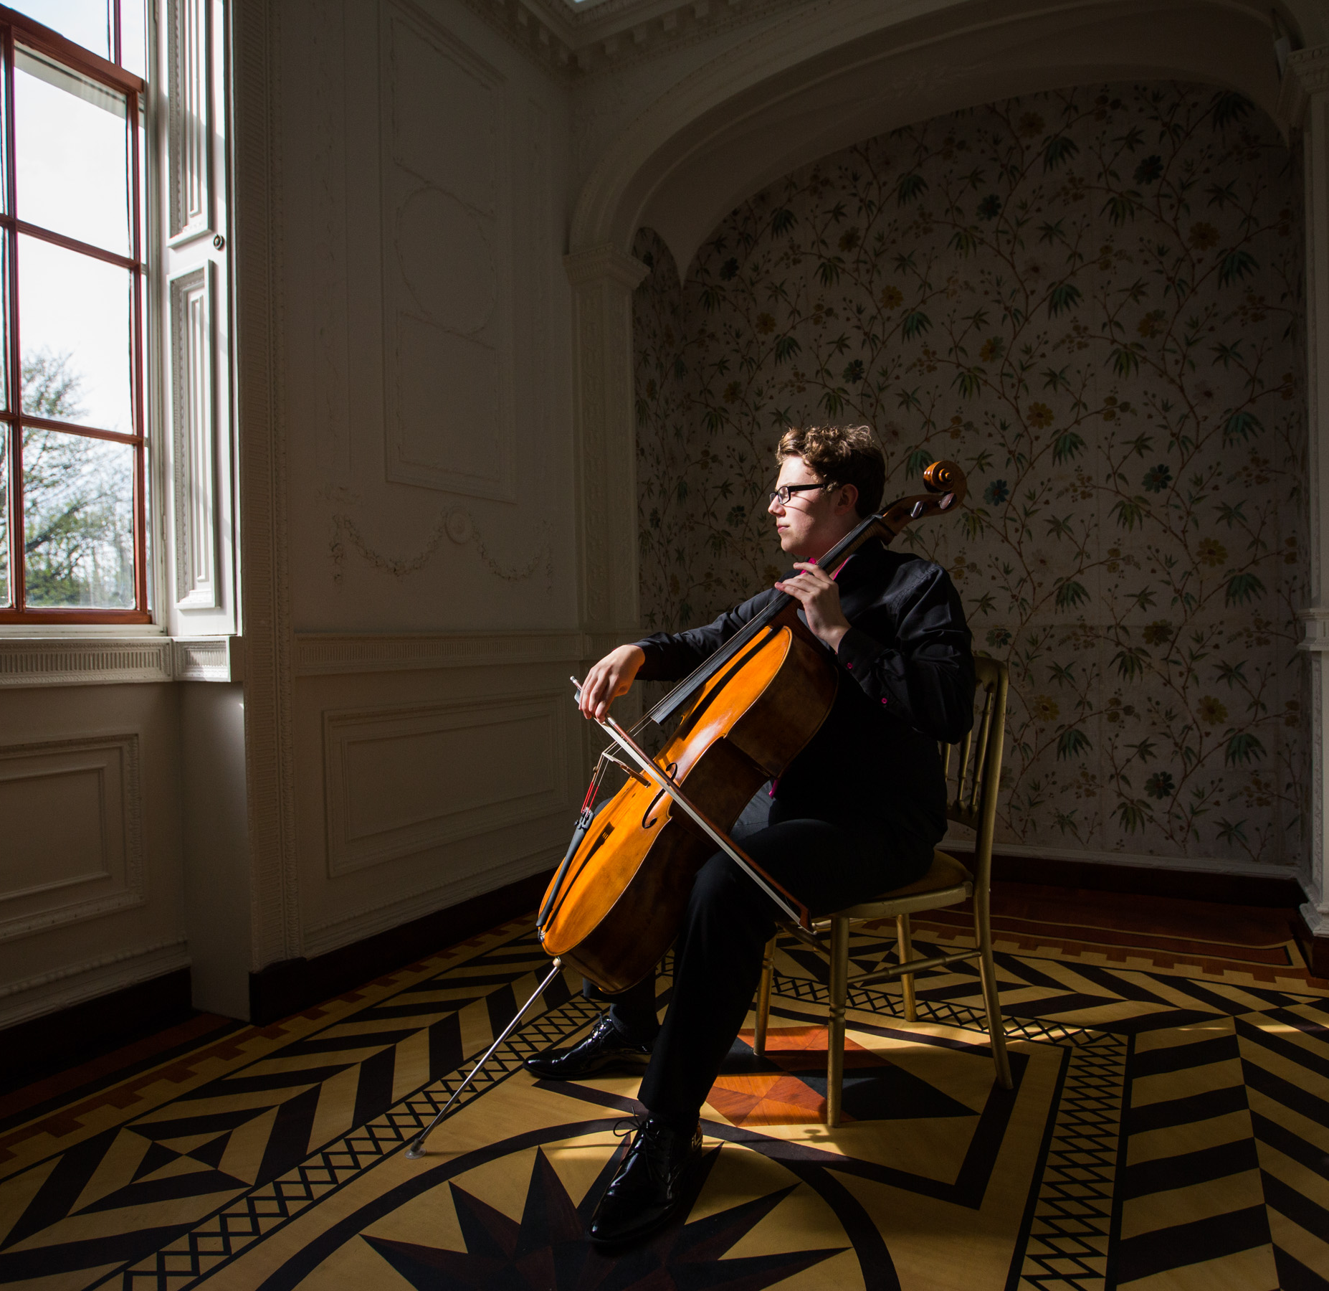
Great Music in Irish Houses Festival
GMIIHF founded in 1970 by David Laing
Provides audiences with access to high- quality chamber music experiences in interesting, non-traditional and intimate spaces
Great Artists, Great Music, Great Spaces with Audiences at the heart of it all

Slide 3
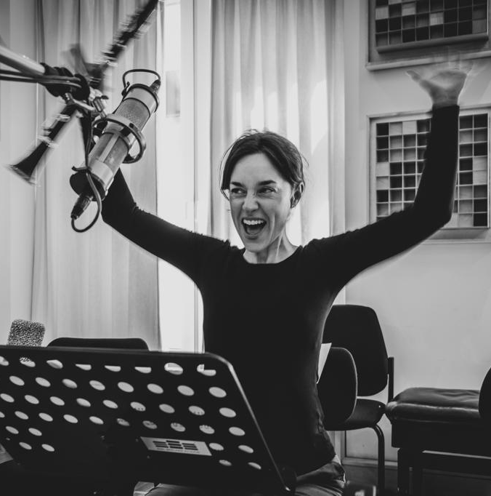
DIGITAL PUBLIC ENGAGEMENT:
OUR FIRST RESPONSE
Celebrating our 50th Birthday on June 7th
Connecting with our Audiences virtually
RTÉ lyric fm Partnership
Virtual Talks using Zoom/Facebook Platforms
Multi-Screen performance of Steve Reich’s “New York Counterpoint” by clarinettist, Carol McGonnell
Musical contributions from the homes of almost 20 musicians
Audience Participation Online - Written/Filmed Messages
Virtual Party on Zoom for Artists/Creatives, Board and Team

Slide 4
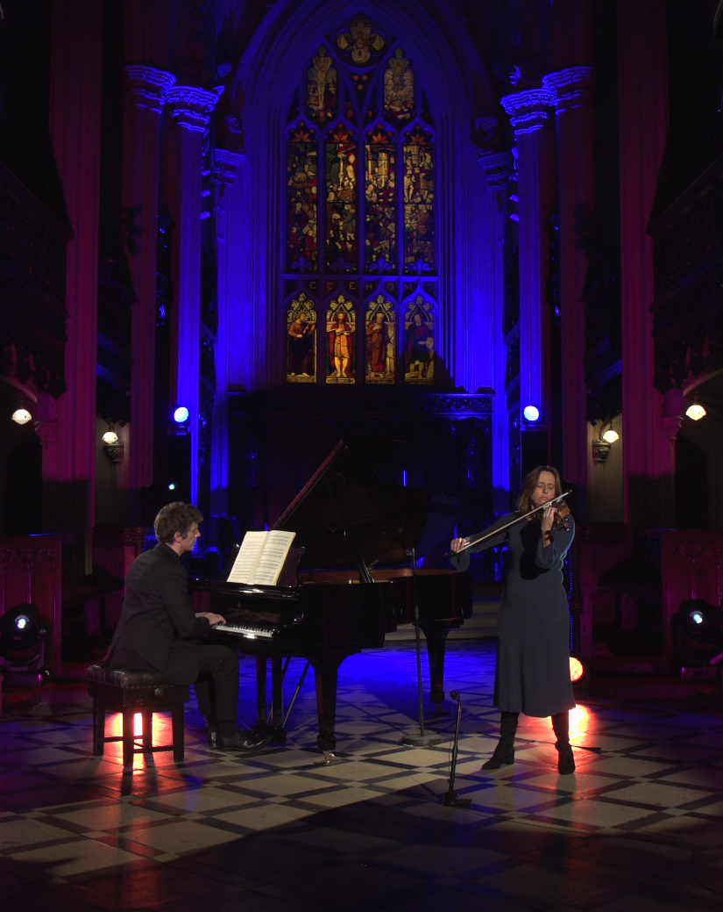
DIGITAL PUBLIC ENGAGEMENT:
NEW YEAR’S EVE 2020
Music: A Message of Hope
New Year’s Eve 2020
The power of music to connect and speak to audiences
Took inspiration from a work of “unfailing light, immutable hope” – Messiaen’s “Quartet for the End of Time”.
Worked with 6 leading Irish/Irish-based musicians and film, sound and lighting experts
Partnered with the Office of Public Works, French and German Embassies and the Irish Chamber Orchestra
“Thank you. This music and these musicians are a light burning in the darkness”

Slide 5
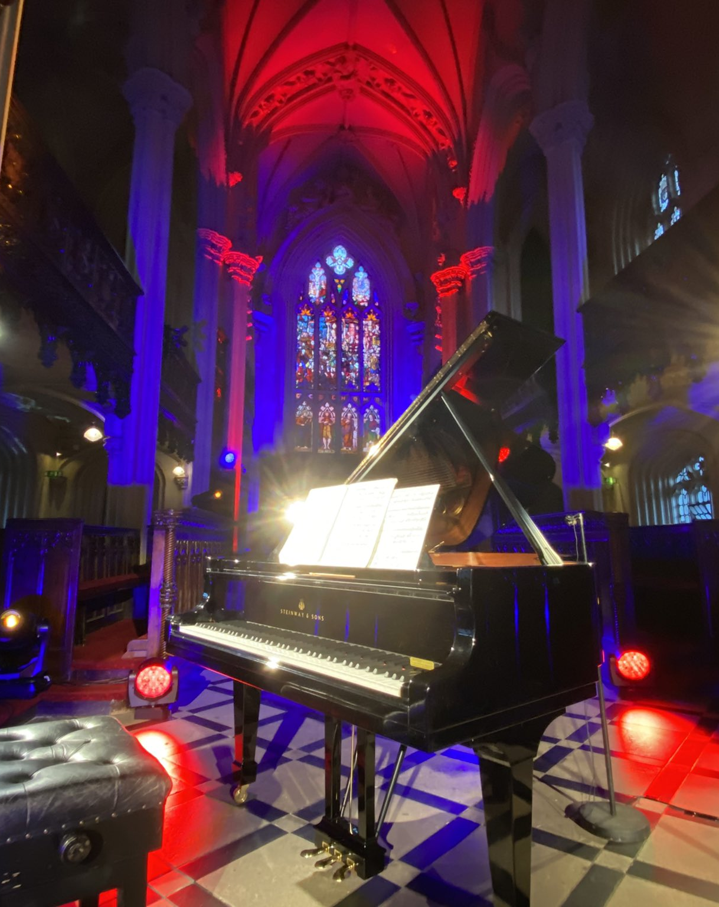
LEARNINGS
Successful experiences of digital public engagement absolutely possible.
Steep learning curve for GMIIHF
Importance of listening to both the sector and to audiences
Meaningful/engaging programming has the power to access a wider audience beyond the concert space
Headspace and patience are important.

Slide 6
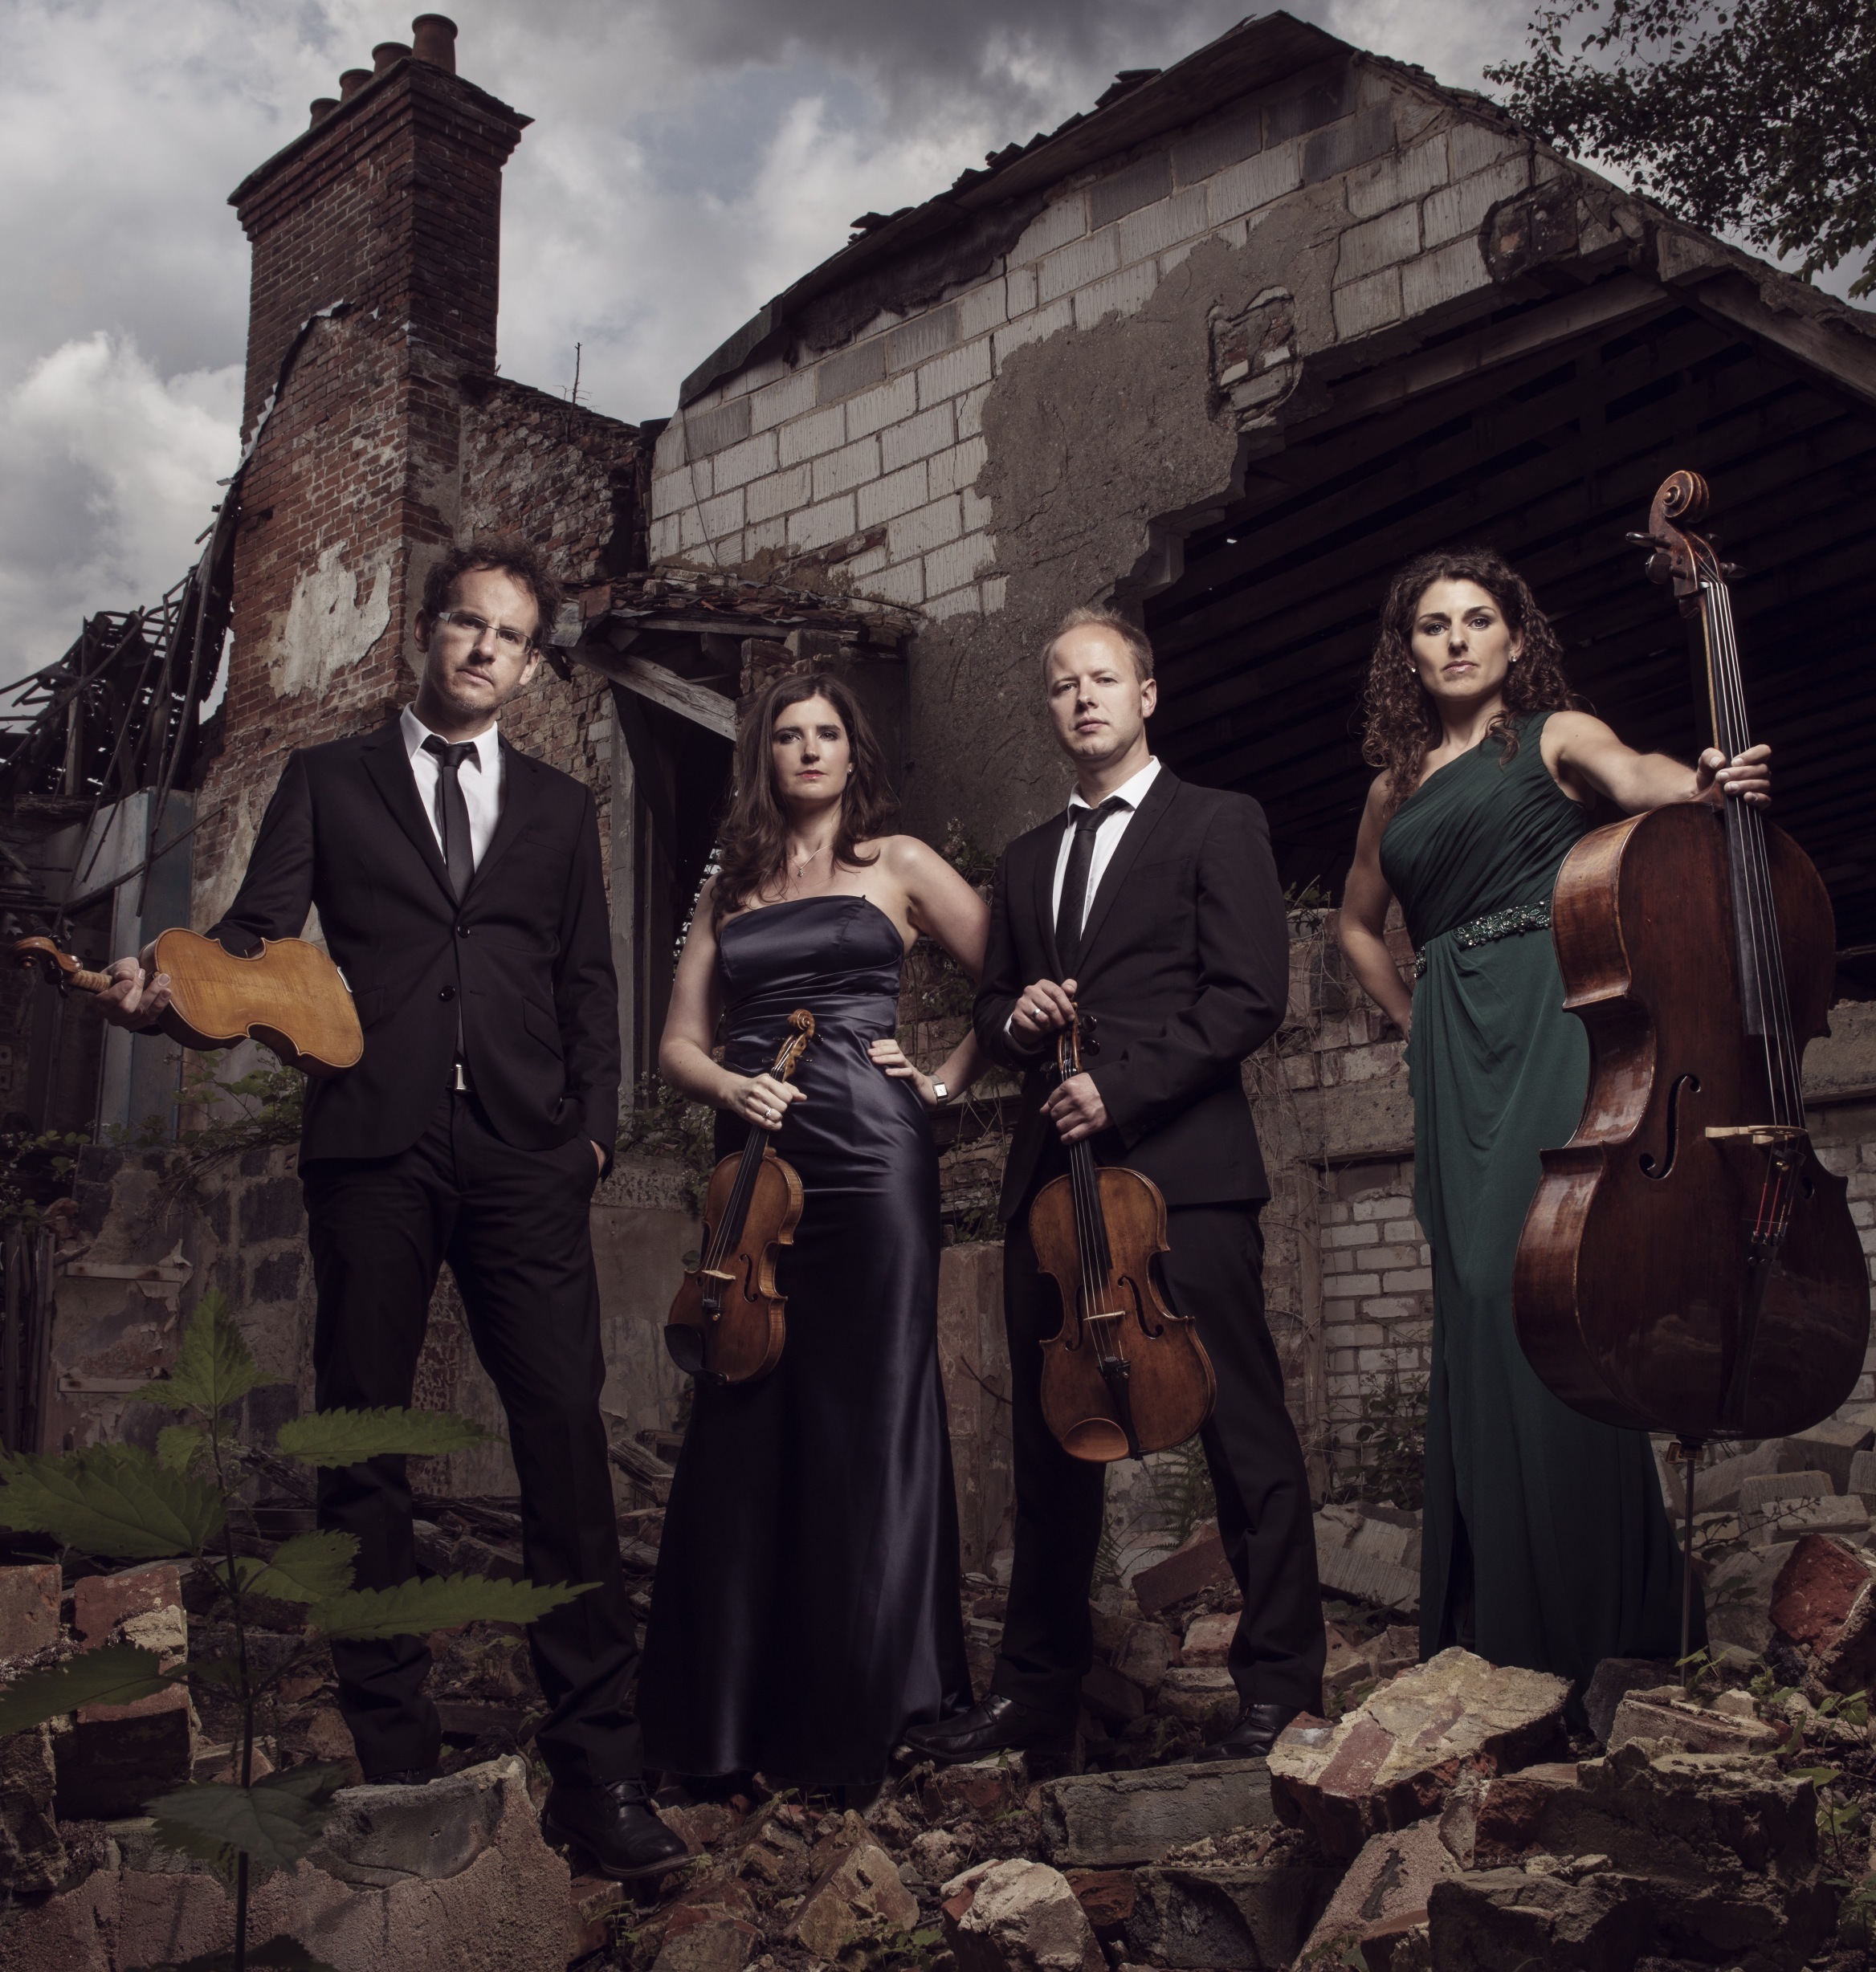
PLANS FOR 2021
International partnerships and presentations online in June 2021
Outdoor performances in the parklands and gardens of a number of OPW sites
Programming strands reflecting the times we are living in
The hope for some live performances in front of our treasured audiences!

